Slide 1
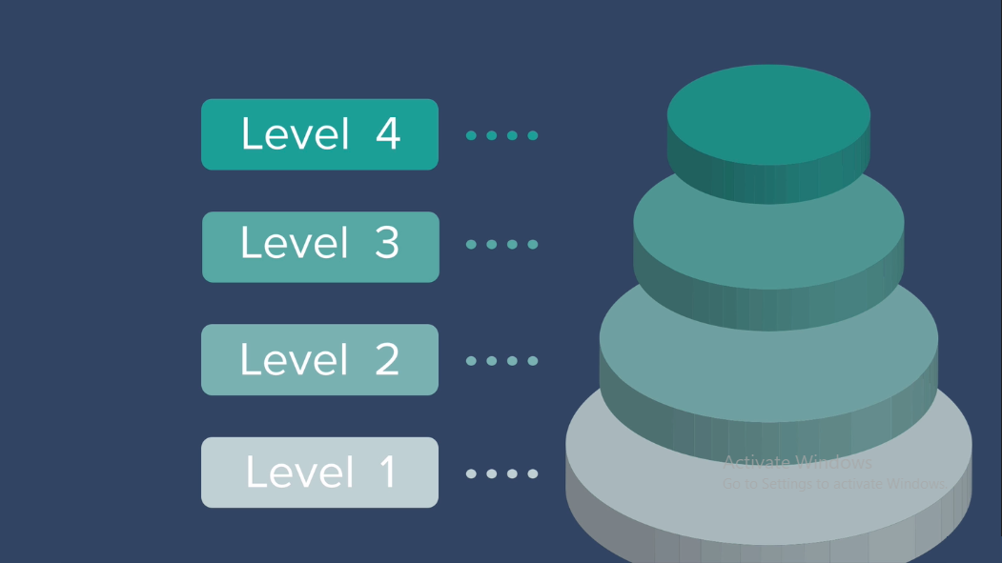
Level Up our Security in Web Application

Slide 2
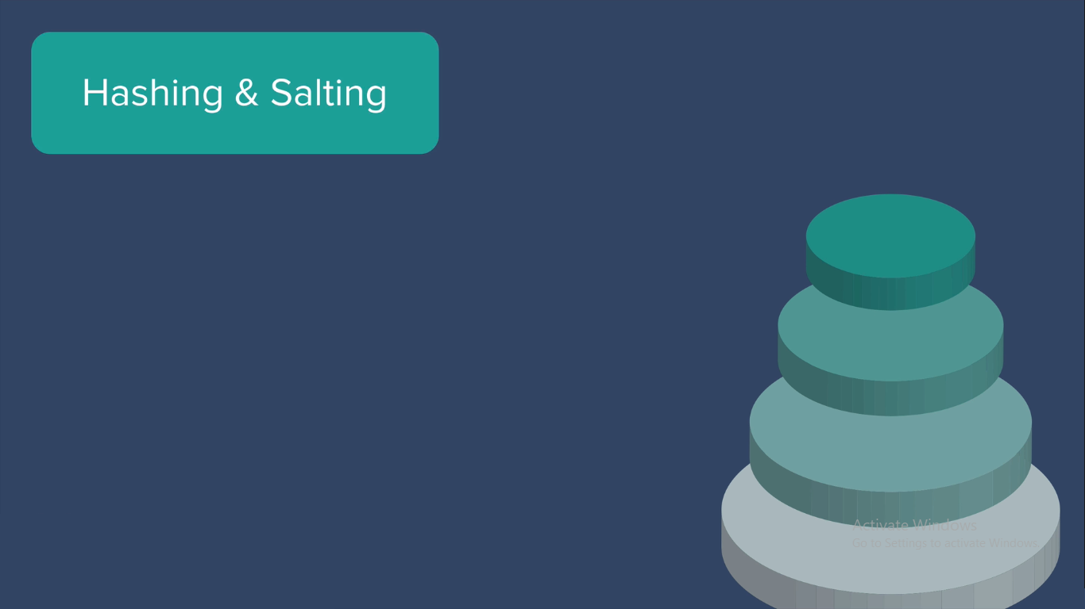

Slide 3
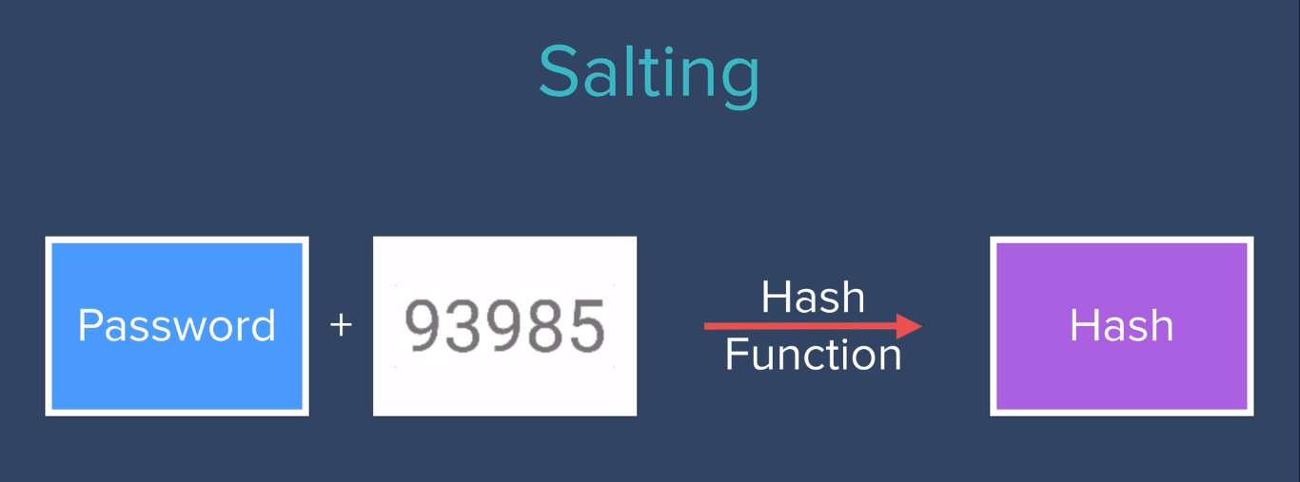
Adding Random Number with Actual Password

Slide 4
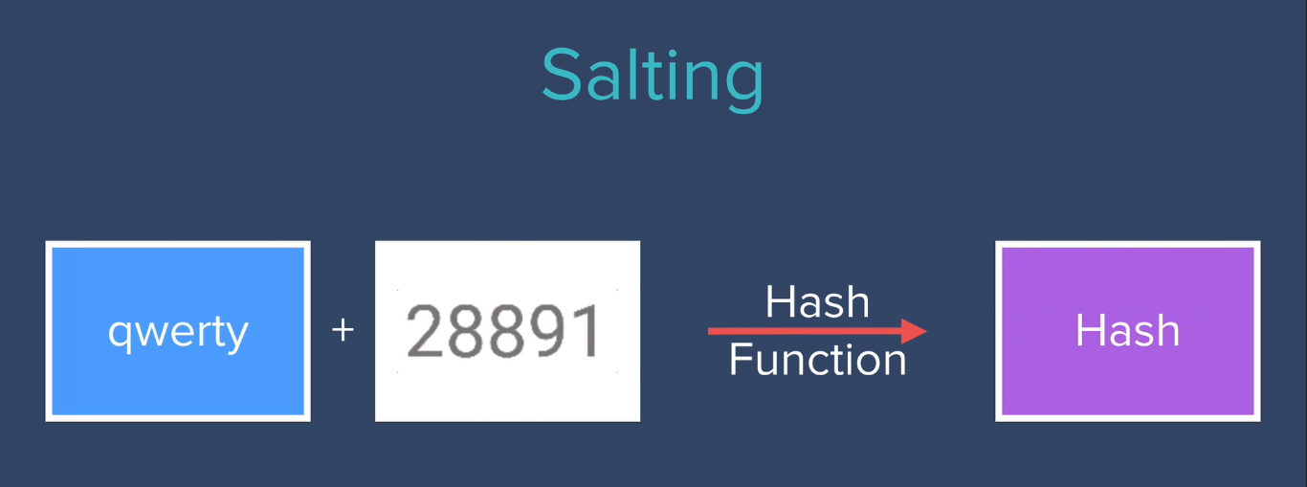
Adding Random Number with Actual Password

Slide 5
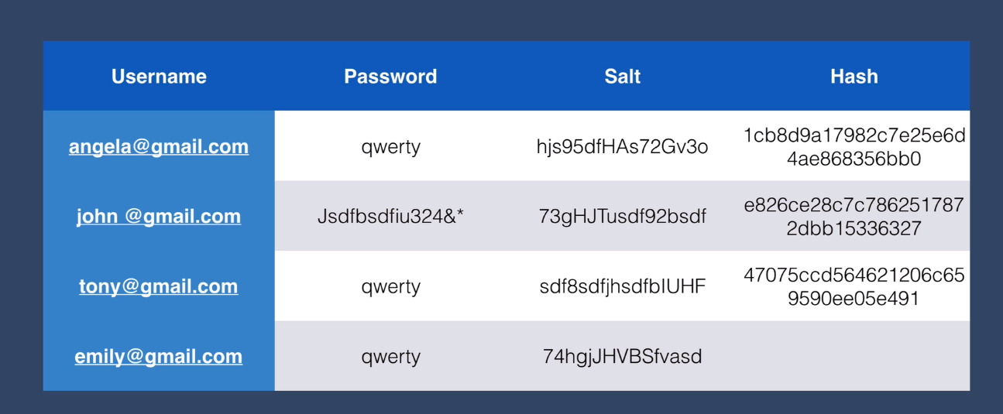
Hashing & Salting

Slide 6
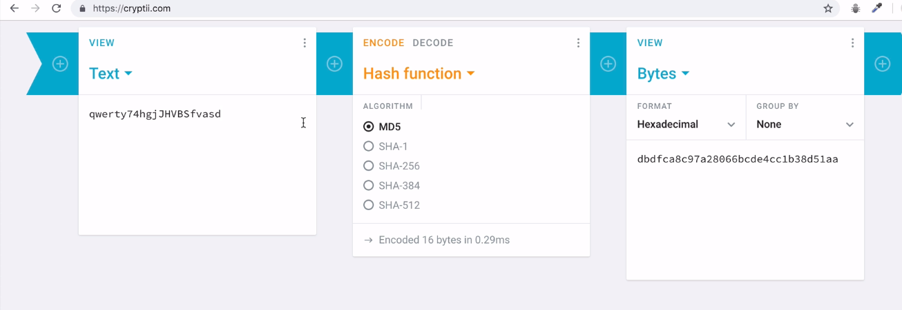
Hashing & Salting

Slide 7
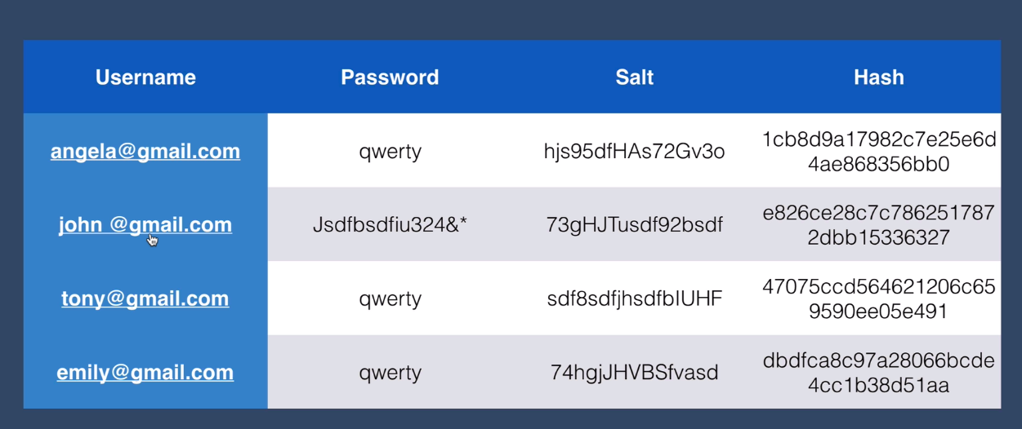
Hashing & Salting

Slide 8
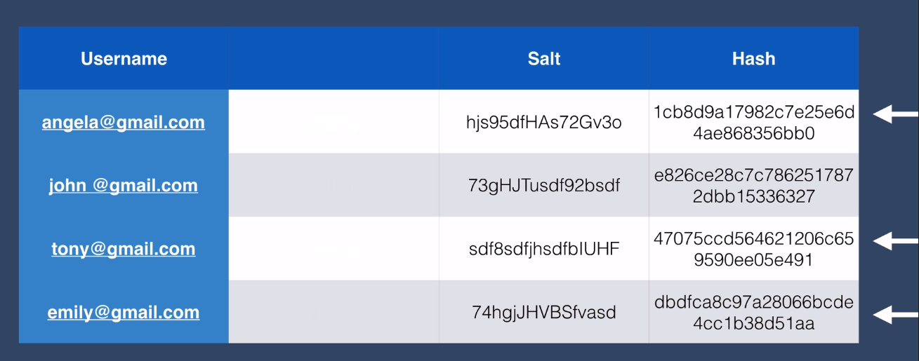
At Database : Hash & Salt

Slide 9
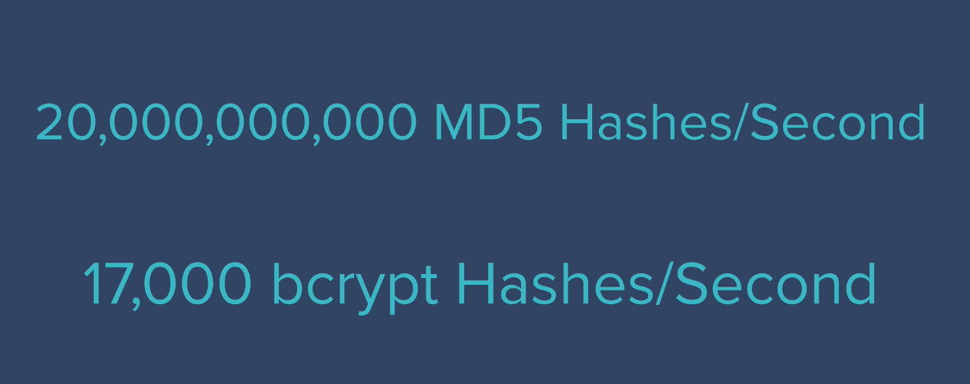
GPU Can produce below count: Parallel Processing

Slide 10
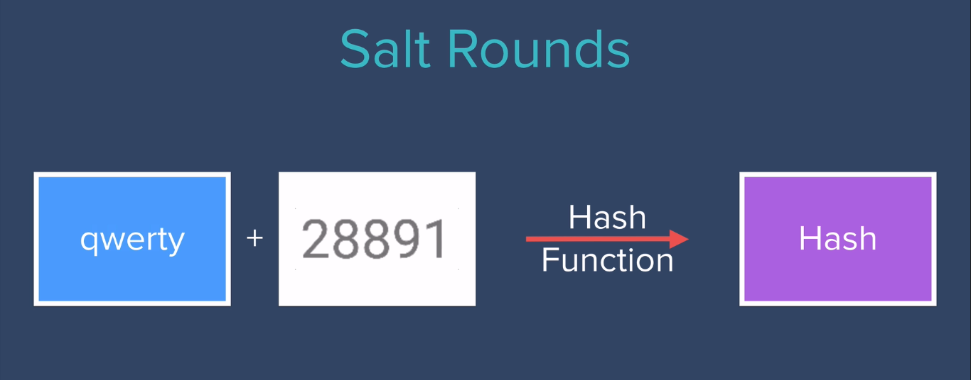
Hash & Salt : Round-I

Slide 11
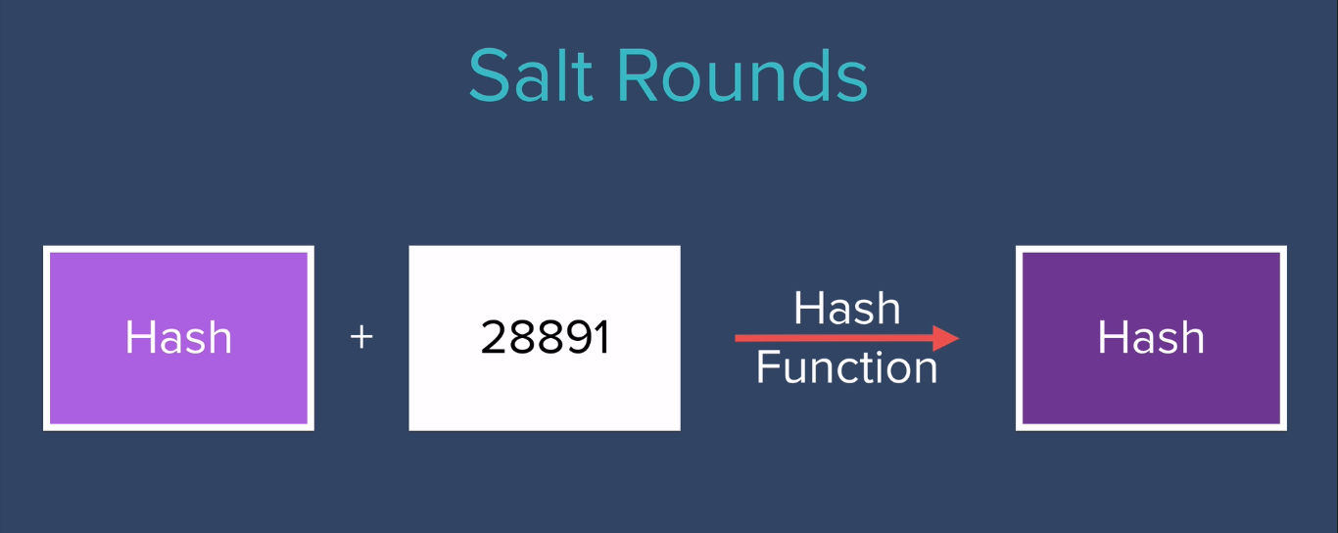
Hash & Salt : Round-II

Slide 12
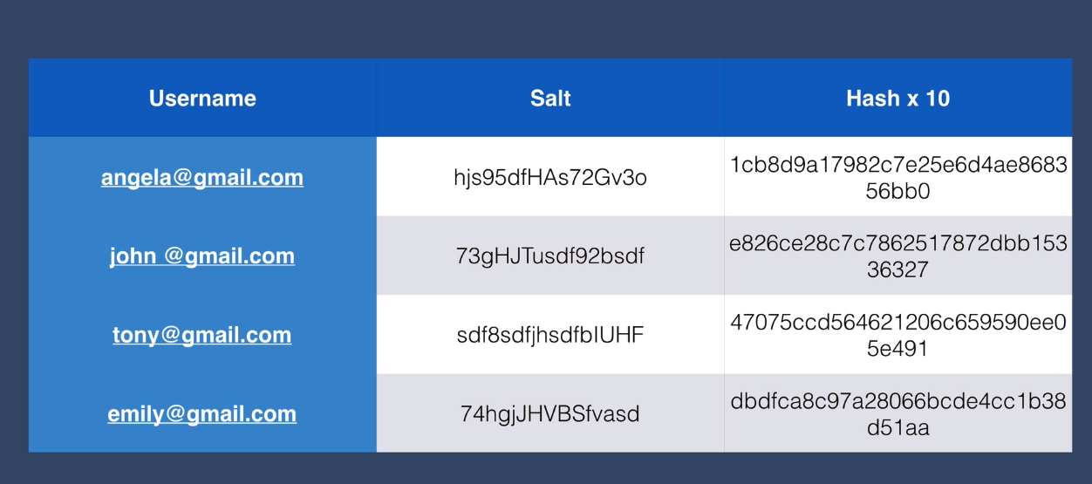

Slide 13
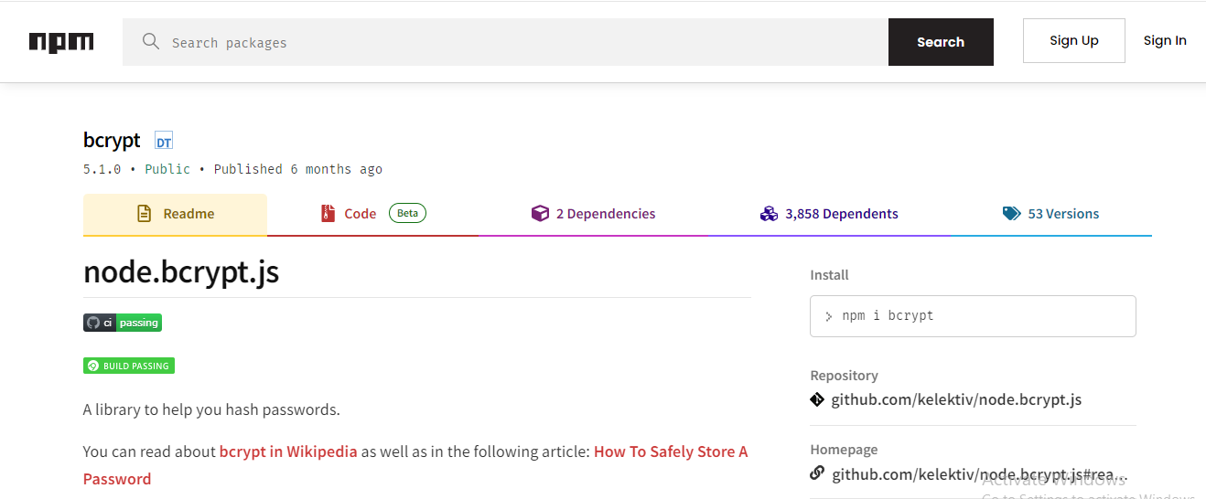

Slide 14
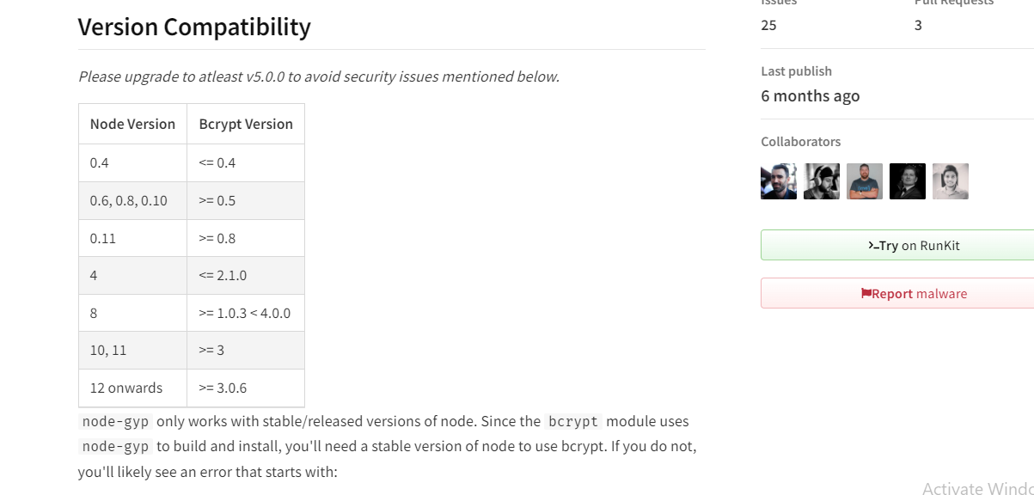
Check Node Version before install bcrypt

Slide 15
Every npm package is having GitHub Home page
and inside home page , it is having issues page.
It helps developers to fix if any error occurs when
Installing particular package.

Slide 16
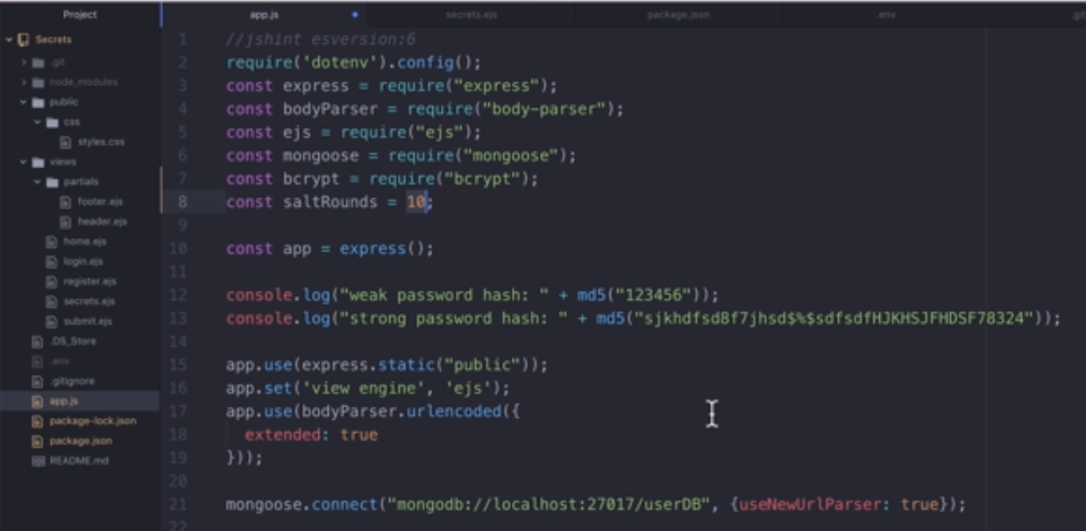
Import Bcrypt package and assign salt rounds

Slide 17
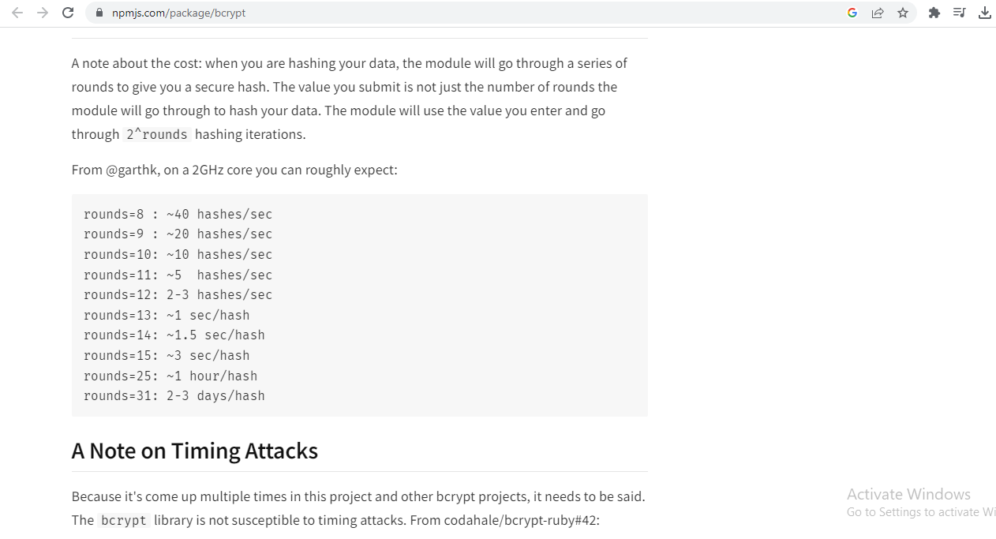
Note Rounds will increase the hacking time.

Slide 18
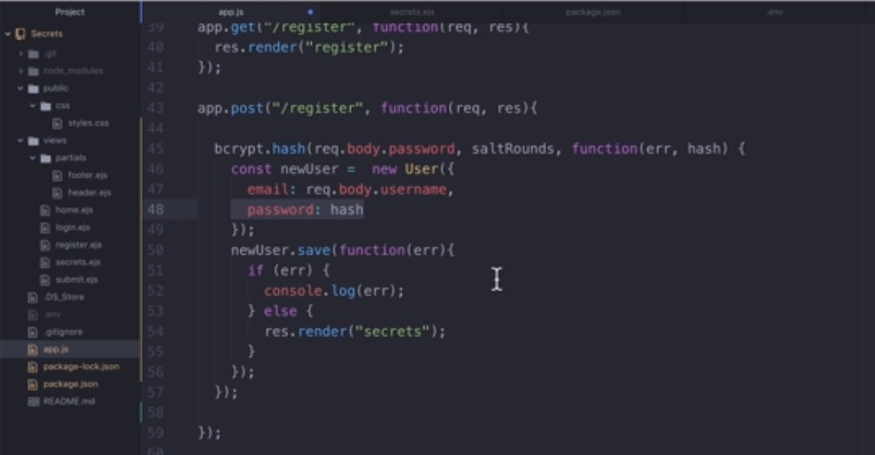
Add bcrypt code at register route

Slide 19
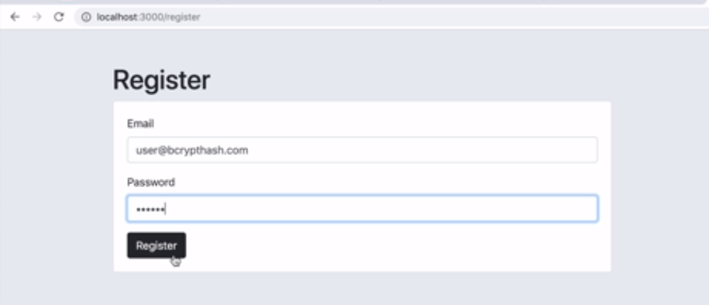

Slide 20
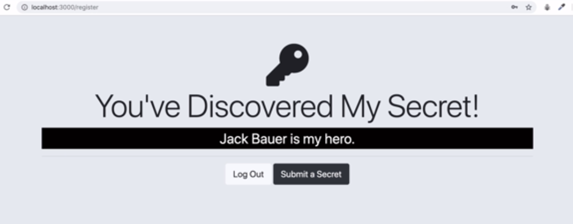

Slide 21
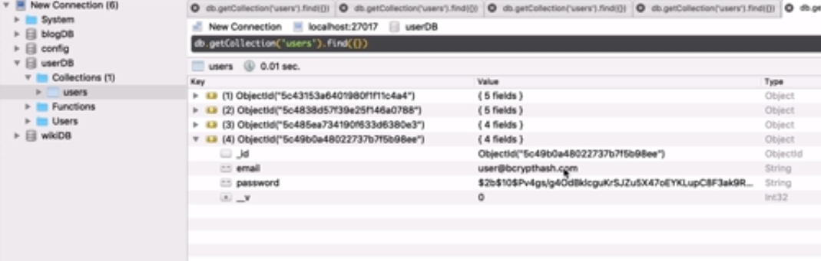

Slide 22
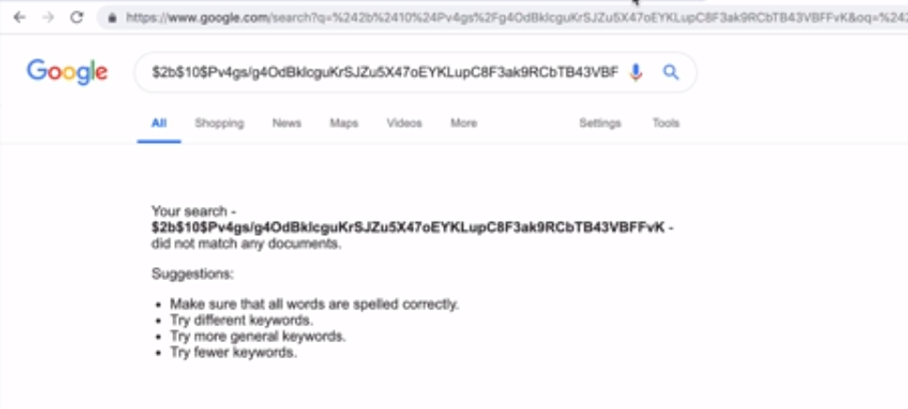
Bcrypted hash cannot be tracked at Google

Slide 23
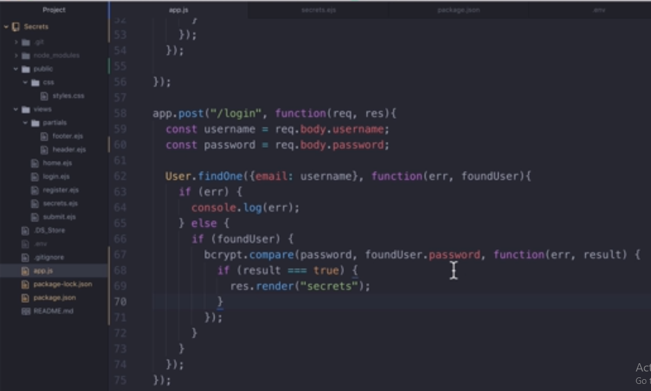
Login Code of bcrypt Package

Slide 24
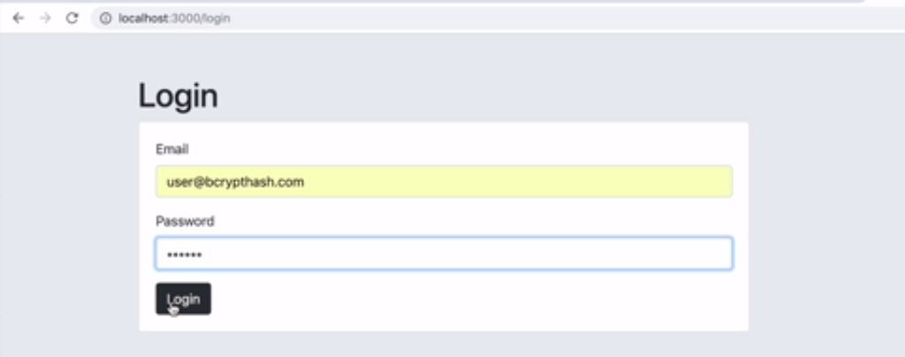

Slide 25


